Slide 1
Lab 1: Creating Database

Slide 2
Create and delete Schema
CREATE SCHEMA Shop;
DROP DATABASE shop;
USE shop;

Slide 3
Creating Tables
CREATE TABLE Customer(
CustomerID int NOT NULL AUTO_INCREMENT PRIMARY KEY,
CustFirstName varchar(25),
CustMidName varchar(10),
CustLastName varchar(25)
);
desc Customer;

Slide 4
Creating Tables
CREATE TABLE SalesOrder(
OrderID int NOT NULL AUTO_INCREMENT PRIMARY KEY,
OrderDate date,
CustomerID int,
FOREIGN KEY (CustomerID) REFERENCES Customer(CustomerID)
);
desc SalesOrder;

Slide 5
Creating Tables
Create table ‘Product’ with attributes ‘ProductID’ as primary key, ‘ProductName’, ‘UnitPrice’ as decimal, and ‘NumberInStock’.
Create table ‘OrderLine’ with attributes ‘OrderLineID’ as primary key, ‘OrderID’, ‘ProductID’, and ‘QuantityOrdered’. ‘OrderID’ and ‘ProductID’ are foreign keys referred to table ‘SalesOrder’ and ‘Product’ respectively.

Slide 6
Creating Tables
CREATE TABLE Product (
ProductID int NOT NULL AUTO_INCREMENT PRIMARY KEY,
ProductName varchar(25),
UnitPrice decimal,
NumberInStock int
);

Slide 7
Creating Tables
CREATE TABLE OrderLine (
OrderLineID int NOT NULL AUTO_INCREMENT PRIMARY KEY,
OrderID int,
ProductID int,
QuantityOrdered varchar(15),
FOREIGN KEY (OrderID) REFERENCES SalesOrder(OrderID),
FOREIGN KEY (ProductID) REFERENCES Product(ProductID)
);
show tables;

Slide 8
Show database
SHOW DATABASES;
SHOW TABLES;

Slide 9
Populating Tables
INSERT INTO Customer (CustFirstName, CustLastName) VALUES ('John', 'Doe’);
SELECT * FROM Customer;
INSERT INTO Customer (CustFirstName, CustMidName, CustLastName) VALUES ('Bob', 'R.', 'Travis');
SELECT * FROM Customer;

Slide 10
Populating Tables
INSERT INTO Product (ProductID, ProductName, UnitPrice, NumberInStock) VALUES (1, 'Strawberry', 4.99, 16);
SELECT * FROM Product;
ALTER TABLE Product MODIFY UnitPrice decimal (5, 2);
UPDATE Product SET UnitPrice =4.99 WHERE ProductID =1;

Slide 11
Populating Tables
INSERT INTO SalesOrder (OrderDate, CustomerID) VALUES (DATE '2006-10-11', 1);
SELECT * FROM SalesOrder;
INSERT INTO OrderLine (OrderLineID, OrderID, ProductID, QuantityOrdered) VALUES (1,1,1, '3kg');

Slide 12
Useful Row and Table Commands
Table Copying
CREATE TABLE Customer2 AS SELECT * FROM Customer;
CREATE TABLE Customer3 LIKE Customer;

Slide 13
Useful Row and Table Commands
Table Deletion
DROP TABLE Customer3;
Row Deletion
DELETE FROM Customer2 WHERE CustomerID=1.

Slide 14
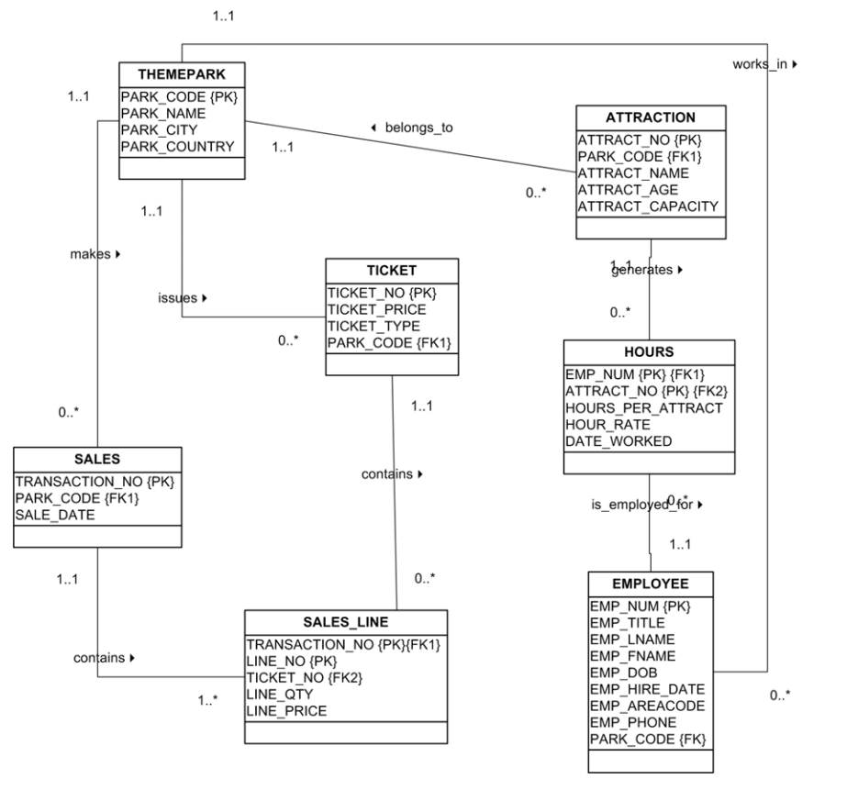

Slide 15
Data dictionary
Table name | Attribute name | Content | Data type | Format | Range | Requi-red | PK/FK | FK referenced table
THEMEPARK | PARK_CODE | Park code | VARCHAR(10) | XXXXXXXX | NA | Y | PK
 | PARK_NAME | Park Name | VARCHAR( 35) | XXXXXXXX | NA | Y
 | PARK_CITY | City | VARCHAR( 50) | XXXXXXXX | NA | Y
 | PARK_COUNTR Y | Country | CHAR(2) | xx | NA | Y

Slide 16
Table name | Attribute name | Content | Data type | Format | Range | Requi-red | PK/FK | FK referenced table
EMPLOYEE | EMP_NUM | Employee number | NUMERIC(4) | #### | 0000 – 9999 | Y | PK
 | EMP_TITLE | Employee title | VARCHAR(4) | XXXX | NA | N
 | EMP_LNAME | Last name | VARCHAR(15) | XXXXXXXX | NA | Y
 | EMP_FNAME | First Name | VARCHAR(15) | XXXXXXXX | NA | Y
 | EMP_DOB | Date of Birth | DATE | YYYY-MM-DD | NA | Y
 | EMP_HIRE_DATE | Hire date | DATE | YYYY-MM-DD | NA | Y
 | EMP_AREACODE | Area code | VARCHAR(4) | XXXX | NA | Y
 | EMP_PHONE | Phone | VARCHAR (12) | XXXXXXXX | NA | Y
 | PARK_CODE | Park code | VARCHAR(10) | XXXXXXXX | NA | Y | FK | THEME PARK

Slide 17
Table name | Attribute name | Content | Data type | Format | Range | Requi-red | PK/FK | FK referenced table
TICKET | TICKET_NO | Ticket number | NUMERIC(10) | ########## | NA | Y | PK
 | TICKET_PRICE | Price | NUMERIC(4,2) | ##.## | NA
 | TICKET_TYPE | Type of ticket | VARCHAR(10) | XXXXXXXX | NA | Y
 | PARK_CODE | Park code | VARCHAR(10) | XXXXXXXX | NA | Y | FK | THEMEPARK
ATTRACTION | ATTRACT_NO | Attraction number | NUMERIC(10) | ########## | NA | Y | PK
 | PARK_CODE | Park code | VARCHAR(10) | XXXXXXXX | NA | Y | FK | THEME PARK
 | ATTRACT_NAME | Name | VARCHAR(35) | XXXXXXXX | NA | Y
 | ATTRACT_AGE | Age | NUMERIC(3) | ### | Default 0 | Y
 | ATTRACT_CAP ACITY | Capacity | NUMERIC(3) | ### | NA | Y

Slide 18
Table name | Attribute name | Content | Data type | Format | Range | Requi-red | PK/FK | FK referenced table
HOUR | EMP_NUM | Employee number | NUMERIC(4) | #### | NA | Y | PK/FK | EMPLOYEE
 | ATTRACT_NO | Attraction number | NUMERIC(10) | ########## | NA | Y | PK/FK | ATTRACTION
 | HOURS_PER_AT TRACT | Number of hours | NUMERIC(2) | ## | NA | Y
 | HOUR_RATE | Hourly Rate | NUMERIC(4,2) | ##.## | NA | Y
 | DATE_WORKED | Date worked | DATE | YYYY-MM-DD | NA | Y

Slide 19
Table name | Attribute name | Content | Data type | Format | Range | Requi-red | PK/FK | FK referenced table
SALES | TRANSACTION_ NO | Ticket number | NUMERIC | ########## | NA | Y | PK
 | PARK_CODE | Park code | VARCHAR(10) | XXXXXXXX | NA | Y | FK | THEMEPARK
 | SALE_DATE | Date of Sale | DATE | YYYY-MM-DD | NA | Y
SALESLINE | TRANSACTION_ NO | Transaction No | NUMERIC | ########## | NA | Y | PK / FK | SALES
 | LINE_NO | Line number | NUMERIC(2) | ## | NA | Y
 | TICKET_NO | Ticket number | NUMERIC(10) | ########## | NA | Y | FK | TICKET
 | LINE_QTY | Quantity | NUMERIC (4) | #### | NA | Y
 | LINE_PRICE | Price of line | NUMERIC(9.2) | #######.## | NA | Y

